Slide 1
John fosholt May 16, 2023
Weed warriors

Slide 2
Weed
Warriors -
Dawn
Hendry
and
volunteers

Slide 3
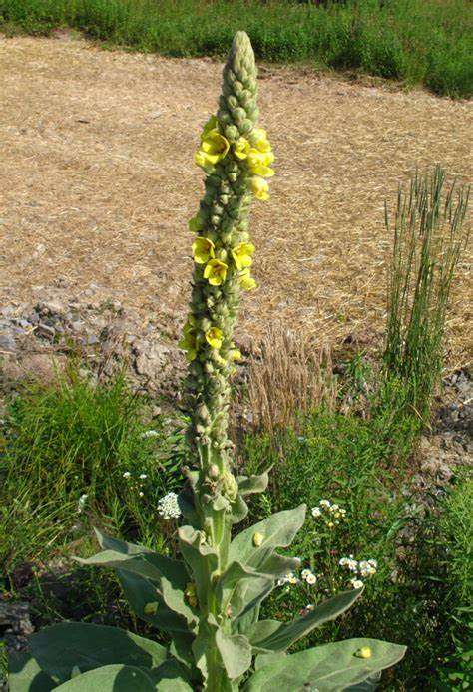
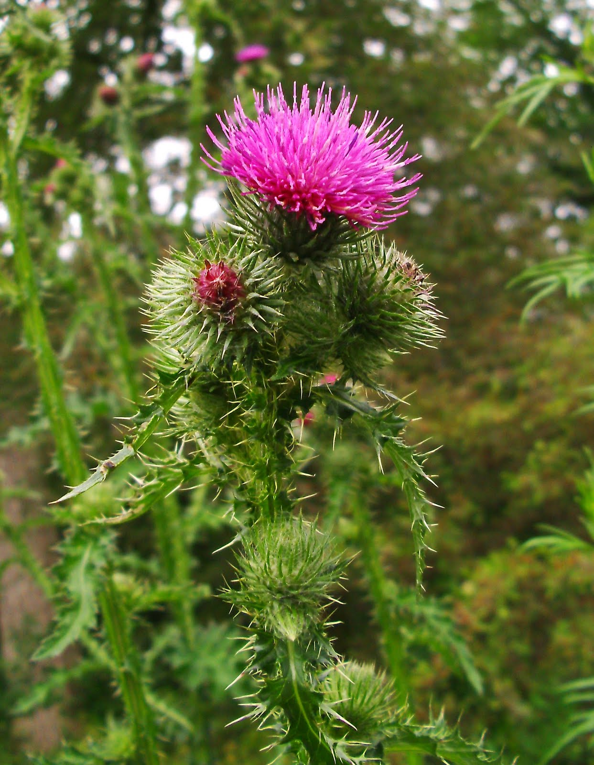
Weed
Warriors -
Target Weeds
Common mullein
Scotch Thistle

Slide 4
Weed warriors -
2022 Weed count

Slide 5
Weed warriors -
Training day

Slide 6
Weed
Warriors -
Training
day
Erlinda stafford
Trail club coordinator
Nick decarolis

Slide 7
Weed warriors
Thank you to our volunteers!!

